Slide 1
Taste Of API
Developing a Food App with RecipeDB & FlavourDB

Slide 2
OBJECTIVE
Taste of API is a user-centric app designed to offer a delightful culinary experience, providing users with the ability to explore various cuisines and plan their meals based on specified calorie requirements.

Slide 3
FUNCTIONALITIES

Slide 4
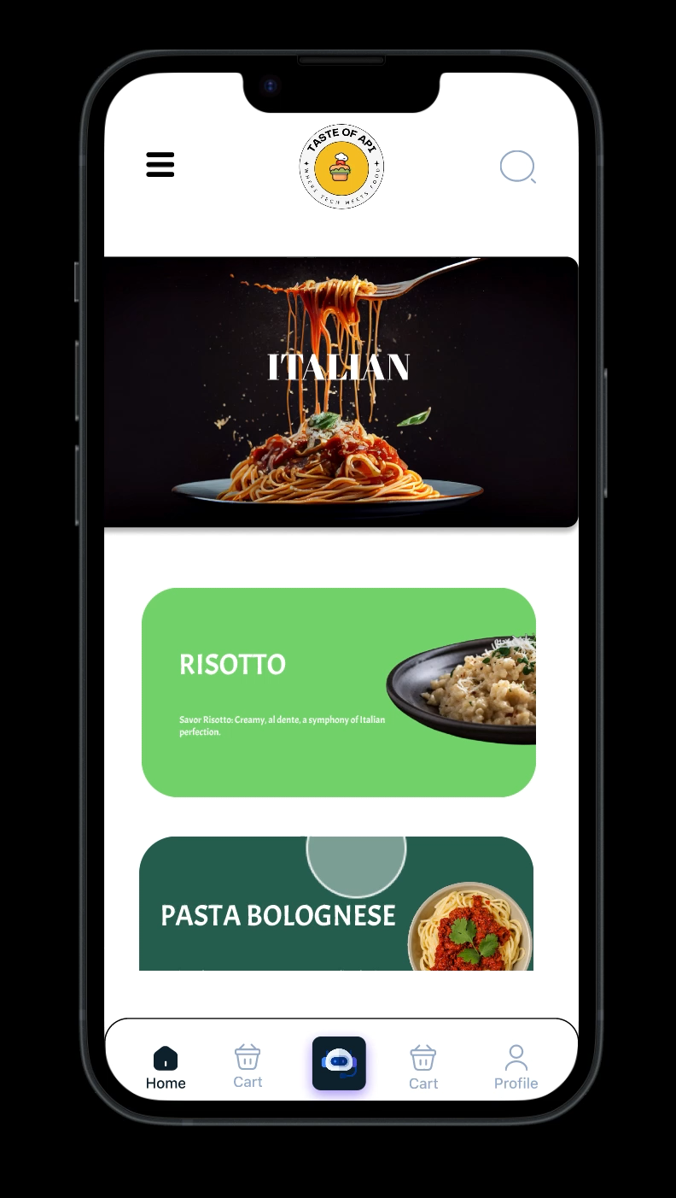
PART 1: UI
Taste of API offers an intuitive interface for exploring cuisines, with a chatbot for personalized recipes. Users can set health preferences, and Flavour DB suggests diverse ingredients for creative dishes. The UI balances simplicity and sophistication, catering to both enthusiasts and small restaurant owners.

Slide 5
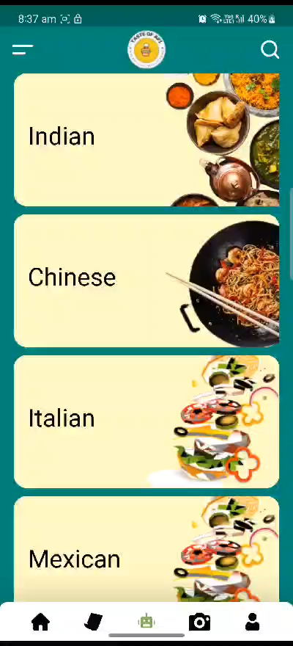
PART 2: ChatBot
Taste of APIs chatbot effortlessly connects with Recipe DB API, responding to user inputs for cuisine, calories, and proteins, delivering personalized recipes. It also taps into Flavour DB API, allowing users to input a dish and receive a list of similar dishes, enhancing culinary creativity.

Slide 6
Recipe DB

Slide 7
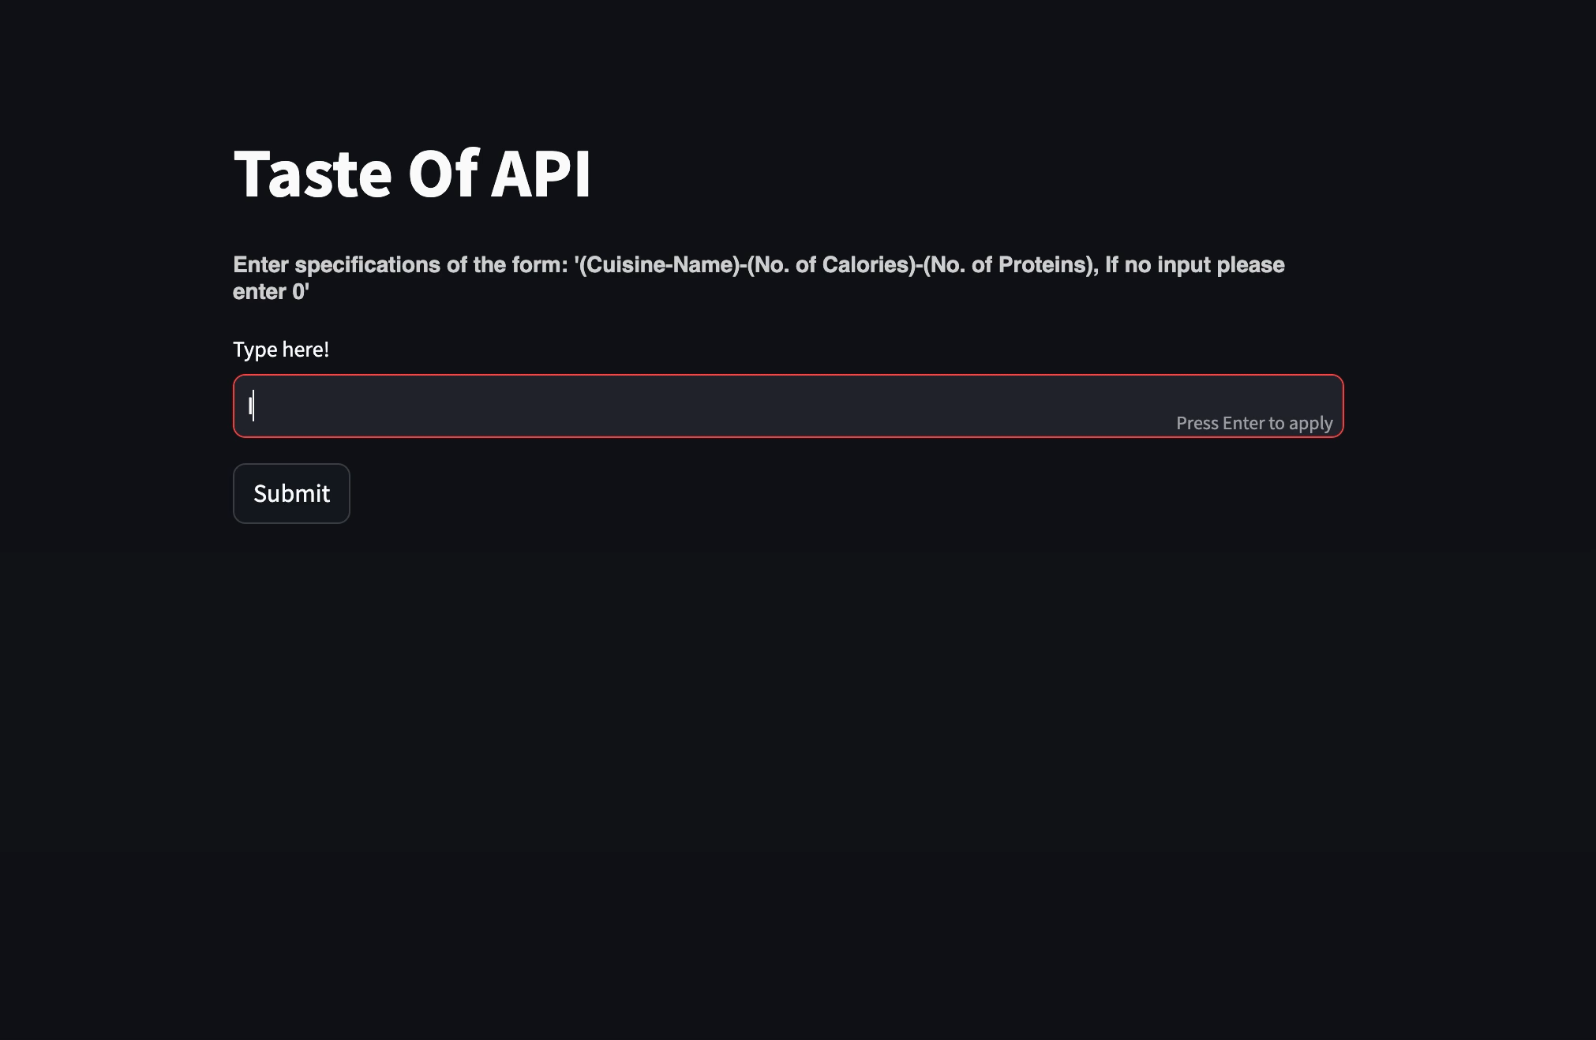

Slide 8
Flavor DB

Slide 9
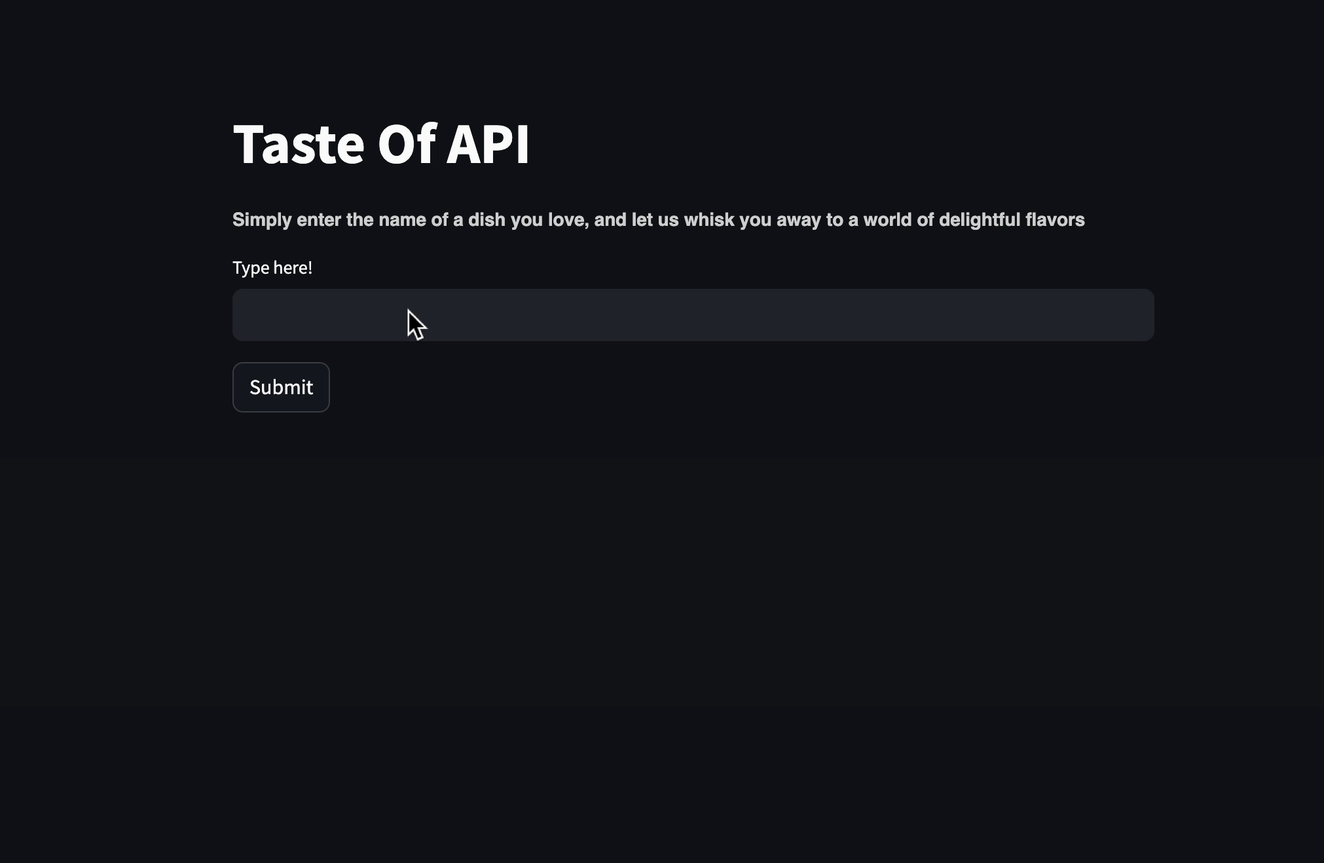

Slide 10
Benefits:
Diverse Culinary Exploration: Users can discover and learn about various cuisines with detailed information and images, enhancing their culinary knowledge.
Healthy Meal Planning: Health-conscious individuals can effortlessly plan meals within their specified calorie range, promoting mindful eating.
User-friendly Interface: The app provides a seamless and user-friendly experience, making it easy for users to navigate and explore culinary options.

Slide 11
Conclusion:
In the world of Taste Of API, we've crafted more than just an app; it's your culinary sidekick! Taste Of API is like a friendly chef guiding you through a world of flavors, making every meal an exciting adventure.
And when it comes to eating healthy, we've got your back! With our Calorie Planner, you set the rules. It's like having a personal nutritionist suggesting tasty dishes that match your daily goals. So, let Taste Of API be your go-to for flavorful discoveries and mindful bites – where every click brings you closer to a tastier and healthier you!

Slide 12
THANK YOU!
Done By:
Vikranth Udandarao
Harsh Mistry
Noel Tiju
Muthuraj Vairamuthu

